Slide 1
Detecting the Anomaly on ECG
SIGNALS
PROJECT ID:BDE 4
Team Members: Harish M - 21BEC1142
Srikrishna B- 21BEC1518 Rakesh Ram M - 21BEC1836
Guide: Prof. Dr. Sridhar C
SIGNATURE

Slide 2
Introduction
The electrocardiogram (ECG) is a critical tool in the field of medical diagnostics, providing vital insights into the electrical activity of the heart. By capturing the heart's rhythmic patterns, ECG signals play an indispensable role in monitoring cardiac health and ensuring optimal functionality. Any irregularities or abnormalities in these signals—such as arrhythmias, ischemia, or other deviations—can indicate serious underlying health conditions. These abnormalities often serve as early warning signs for life-threatening issues like heart attacks or sudden cardiac arrests. The relevance of ECG monitoring cannot be overstated. With cardiovascular diseases being a leading cause of mortality worldwide, the early detection of ECG anomalies can be a game changer. Timely identification and intervention can save lives by preventing complications, enabling proactive treatment, and significantly improving patient outcomes. As such, advancements in ECG monitoring and analysis are not just technological progress—they are a direct investment in saving lives.

Slide 3
Introduction
Still the major cause of death globally, cardiovascular diseases (CVDs) depend on early diag nosis and monitoring for efficient treatment. Recording the electrical activity of the heart over time helps one to diagnose cardiac diseases using electrocardiogram (ECG). But spotting ab normalities in ECG signals is a difficult chore requiring knowledge and can be prone to human mistake. Manual inspection by medical personnel is the conventional approach of ECG anal ysis, which may be time-consuming and ineffective particularly in an emergency. Automated ECG abnormality identification has emerged as a potential fix for raising diagnostic accuracy and efficiency with the arrival of artificial intelligence (AI) and machine learning (ML). By use of deep learning approaches, this research aims to create a strong AI-driven system capa ble of automatically detecting abnormalities in ECG readings, including arrhythmias and other irregular cardiac rhythms. The suggested method improves the capacity to categorize normal and aberrant ECG signals by using convolutional neural networks (CNNs) and recurrent neural networks (RNNs), hence enhancing cardiac care and patient outcomes.

Slide 4





































































































































































































Problem Statement
The detection of anomalies in ECG signals is a critical task in diagnosing heart- related conditions. However, the current reliance on manual interpretation presents significant challenges. Manual detection is inherently time-consuming, requiring expert analysis and careful observation. This process is not only labor-intensive but also prone to human error, potentially leading to delayed or inaccurate diagnoses. Existing automated systems, while effective in some cases, often come with significant drawbacks. High costs and complex infrastructure make these systems inaccessible to many small-scale clinics, particularly in resource-limited settings. This lack of accessibility creates a gap in healthcare, where advanced diagnostic tools are available primarily in high-end hospitals, leaving underserved communities at a disadvantage. This highlights an urgent need for an innovative solution: an automated system that is both cost-effective and efficient.

Slide 5
Research Objectives
The objective of this project is to develop an efficient system capable of detecting anomalies in ECG signals in real-time, enabling timely identification of potential cardiac issues. The system is designed to prioritize cost-effectiveness and ease of implementation, leveraging Arduino-based hardware for signal acquisition and processing. This ensures accessibility for small-scale clinics and resource-limited settings. Additionally, Python will be utilized to design and implement robust data analysis and anomaly detection algorithms, ensuring high accuracy and reliability in identifying irregularities. The integration of these components aims to create an affordable, scalable, and user-friendly solution for improved cardiac care.

Slide 6
Research Objectives
Key Objectives
Develop an ECG anomaly detection system using hardware and AI.
Design a PCB with ECG sensor for real-time signal acquisition.
Preprocess noisy ECG signals for better accuracy.
Implement machine learning/deep learning models for anomaly classification.

Slide 7







































































































































Proposed system
Proposed System Overview
Overview of the Proposed System
Hardware: Custom PCB with ECG sensor & signal processing circuits.
Software: AI-based anomaly detection model in Python.
Data Processing: Filtering, feature extraction, and classification.
Output: Classification as normal/abnormal ECG with visualization.

Slide 8
Proposed System
The proposed system focuses on the real-time detection and analysis of ECG anomalies. For data acquisition, an Arduino- based setup is employed to collect ECG signals using specialized sensors. These signals are processed in the processing and detection phase, where Python is used for preprocessing tasks such as noise reduction and signal filtering. Advanced machine learning models or anomaly detection algorithms are then applied to classify signals as normal or abnormal with high accuracy. To enhance usability, an interactive dashboard displays real-time results, enabling quick interpretation.
Additionally, AutoCAD and Tinkercad are used for hardware design and simulation, ensuring seamless integration of the components.

Slide 9
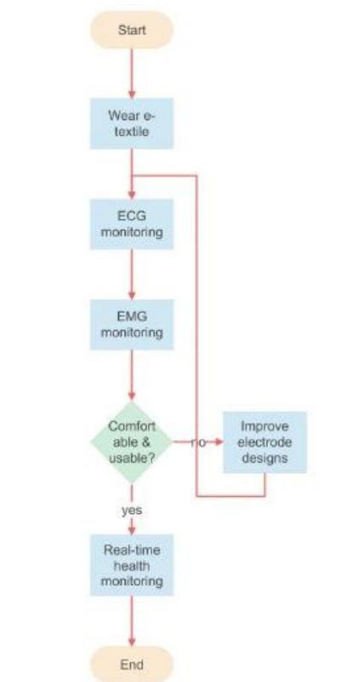
System diagram
Accurate
monitoring

Slide 10
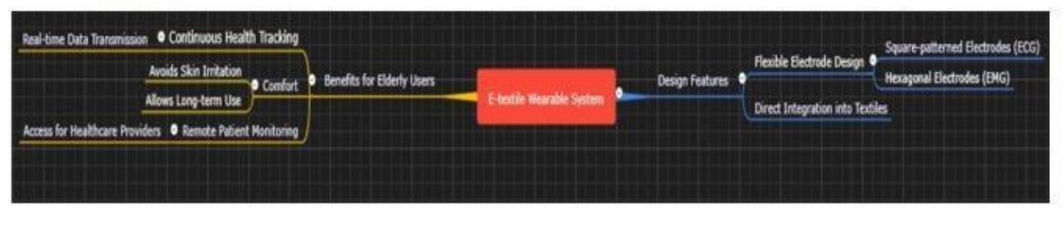
System diagram
Accurate
monitoring

Slide 11
Modules listed and detailed explanation
Hardware Design
PCB Fabrication: Square & circle design for optimal signal processing.
ECG Sensor & Components: Electrodes, resistors, capacitors, and amplifiers.
Soldering & Wiring: Ensuring proper connections to minimize noise.

Slide 12
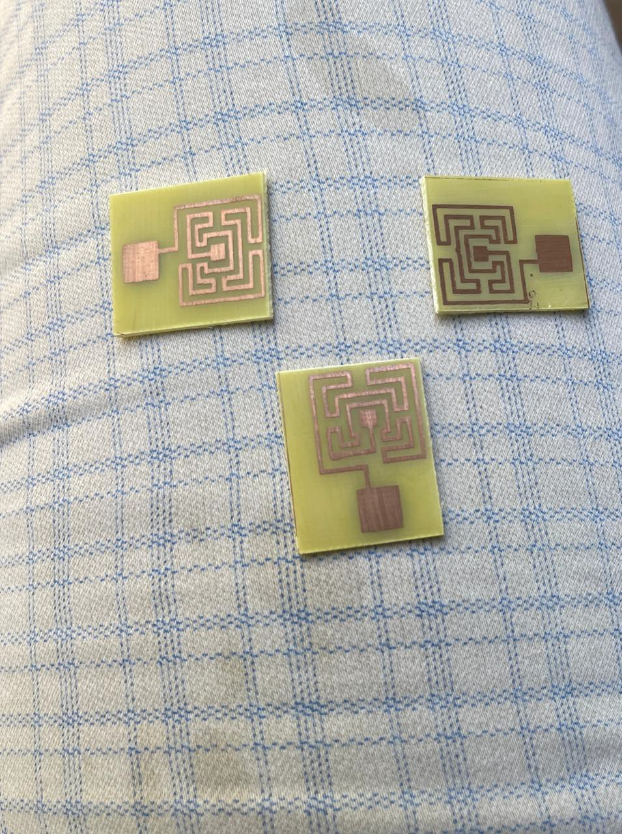
Modules listed and detailed explanation
Hardware Design

Slide 13
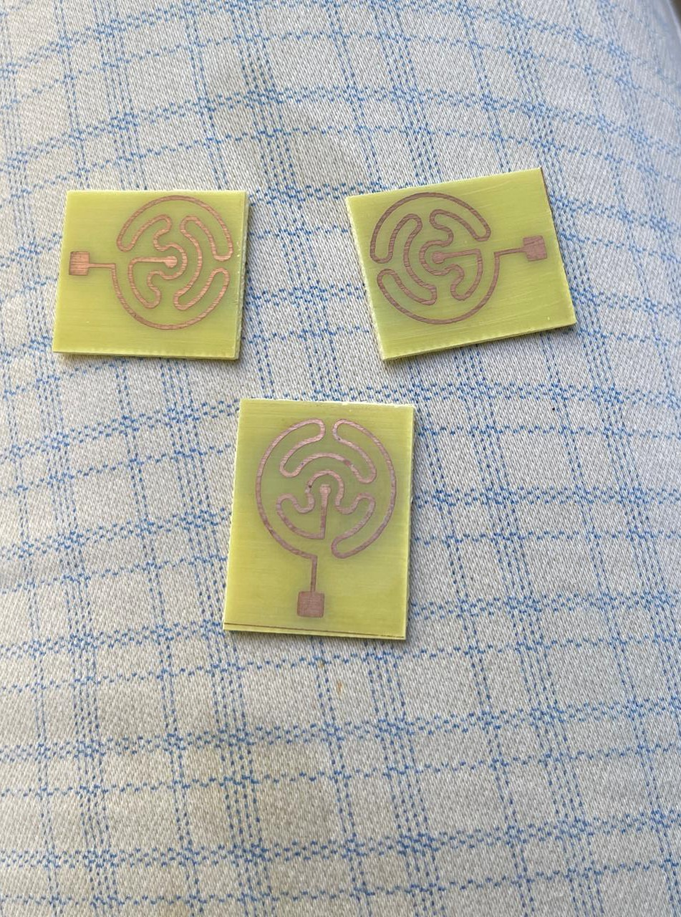
Modules listed and detailed explanation
Hardware Design

Slide 14
Modules listed and detailed explanation
Signal Processing
Noise Reduction Techniques:
  Band-pass filtering (removes powerline & motion artifacts).
  Wavelet transform for denoising ECG signals.
Feature Extraction: Identifying PQRST peaks & heart rate variability.

Slide 15
_{M}•.
odules listed and detailed explanation
Machine Learning/Deep Learning Model
Model Selection: CNN, LSTM, or traditional ML classifiers (SVM, Ran
Training Data: MIT-BIH arrhythmia dataset / Custom dataset.
Performance Metrics: Accuracy, precision, recall, F1-score.

Slide 16
_{M}•.
odules listed and detailed explanation
Output & Interpretation:
Graphical representation of normal vs. abnormal ECG signals.
Automated classification into normal, arrhythmia, or other heart co

Slide 17
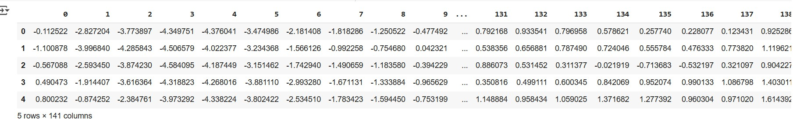
DATASET LOADING

Slide 18
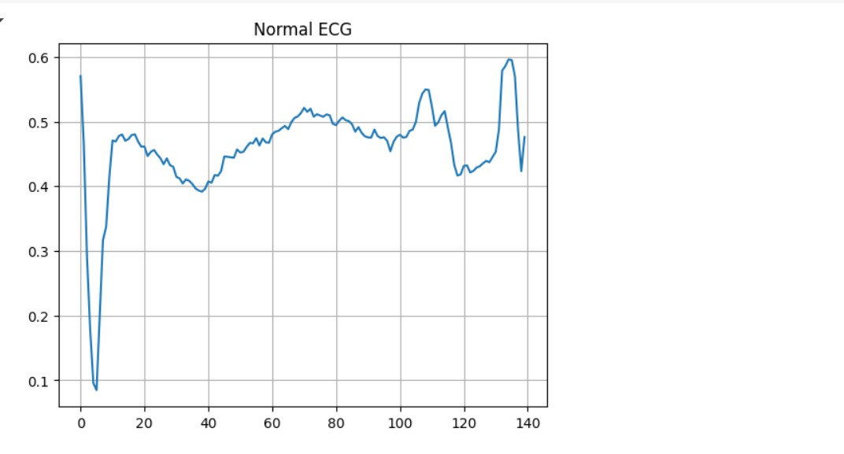
ECG WAVE

Slide 19
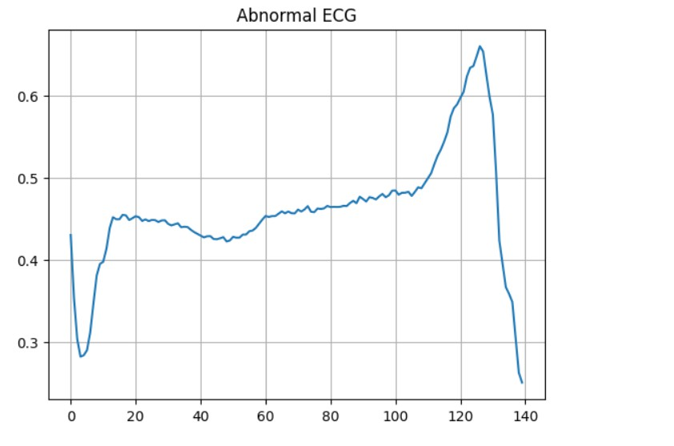
ABNORMAL ECG

Slide 20
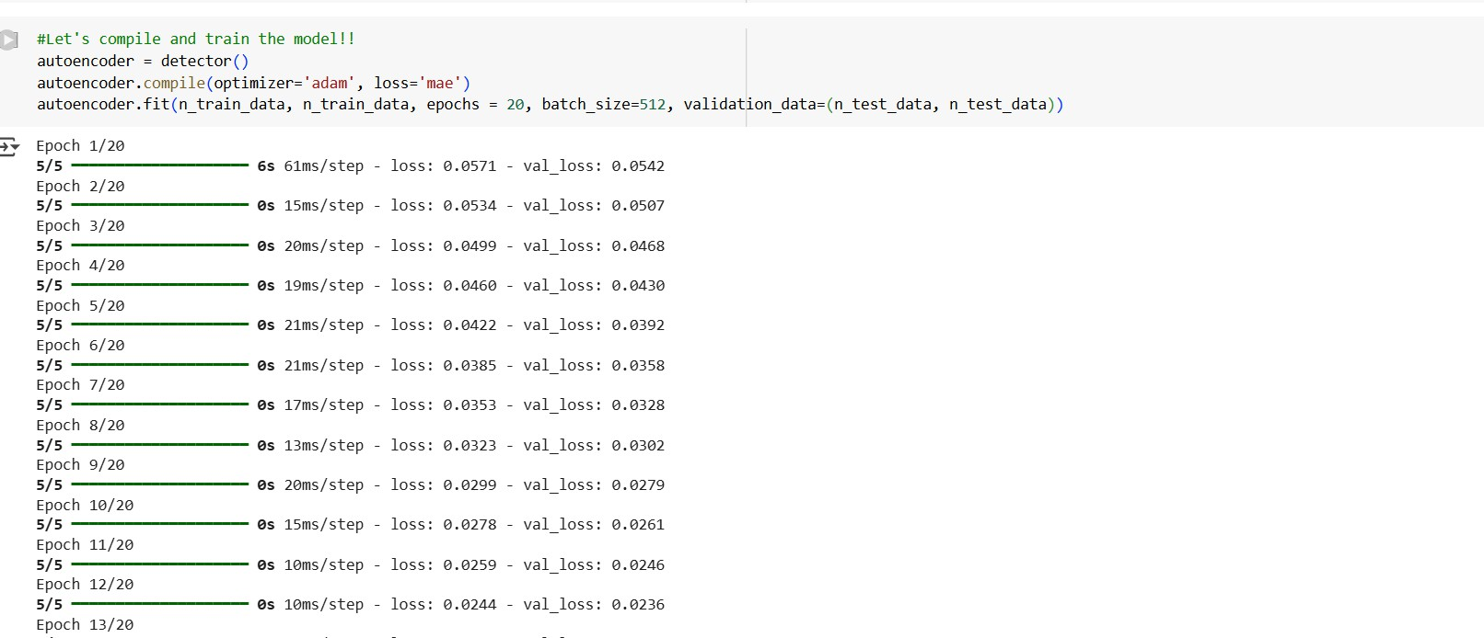
COMPILE AND TRAIN MODEL

Slide 21
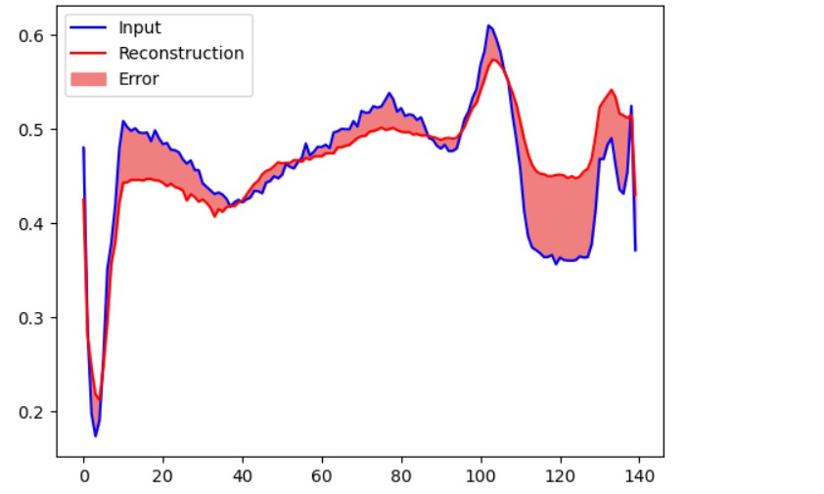
RECONSTURCTION OF ECG SIGNA;L

Slide 22
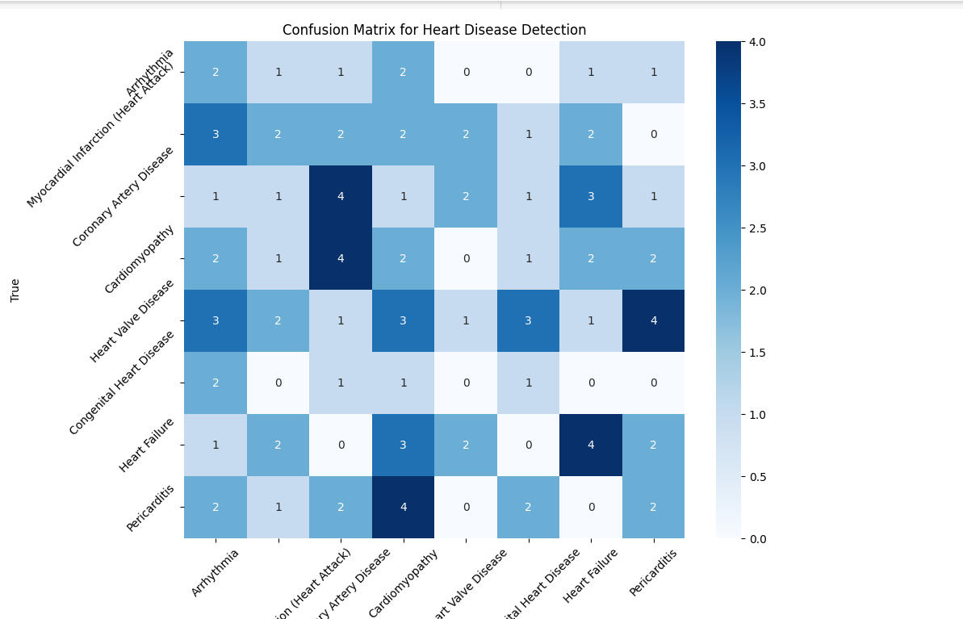
CONFUSION MATRIX FOR HEART DISEASE DETECTION

Slide 23
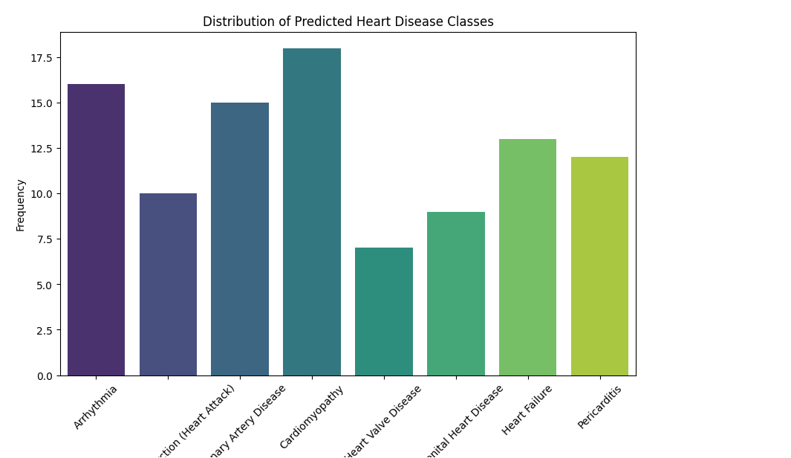
DISTRIBUTION OF PREDICTED HEART DISEASES

Slide 24
•.
Implementation Results:
Model Performance & Evaluation
Confusion Matrix
Precision-Recall Curve
Comparison with existing ECG anomaly detection methods Graphs & Visualizations
Raw ECG signal vs. filtered ECG signal.
Anomaly detection in real-time ECG data.
Equations used in signal processing and feature extraction.

Slide 25
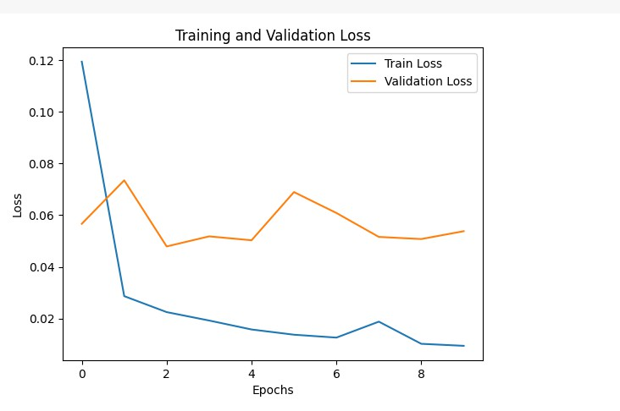
TRAINING AND VALIDATION LOSS

Slide 26
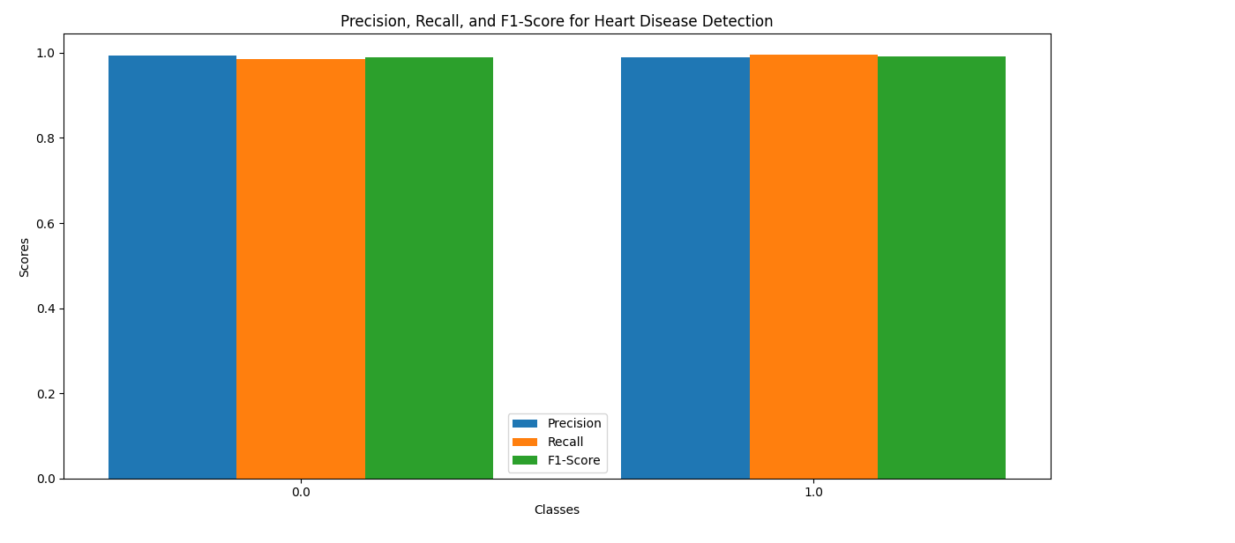
precision ,recall and f1 score

Slide 27
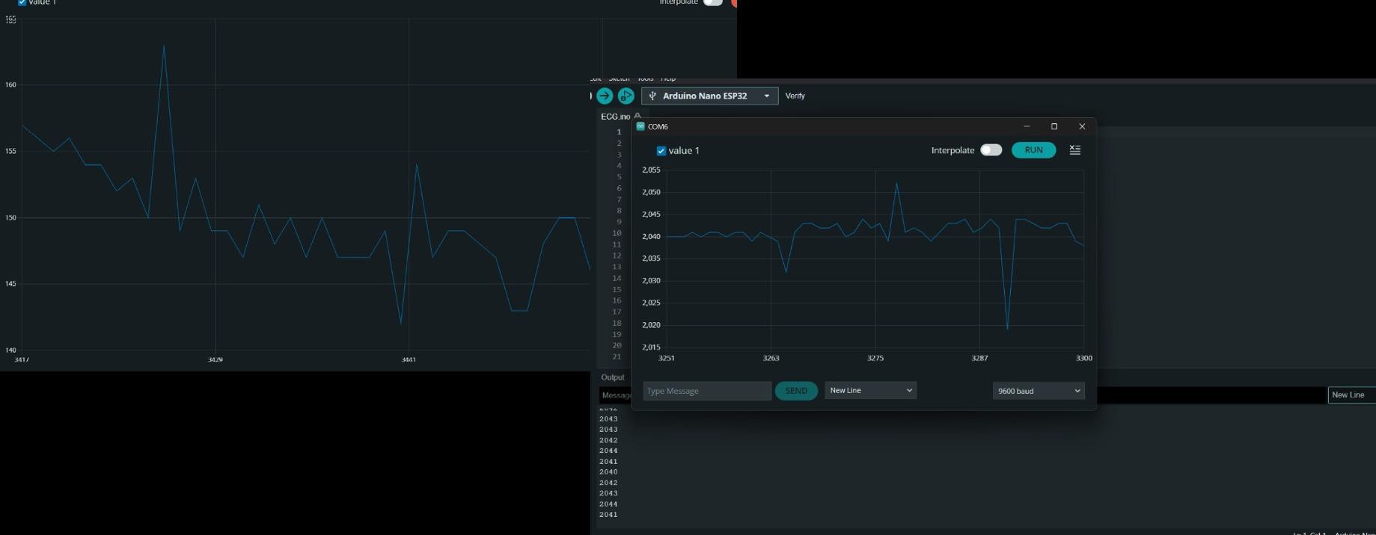
MANUAL ECG SIGNAL

Slide 28
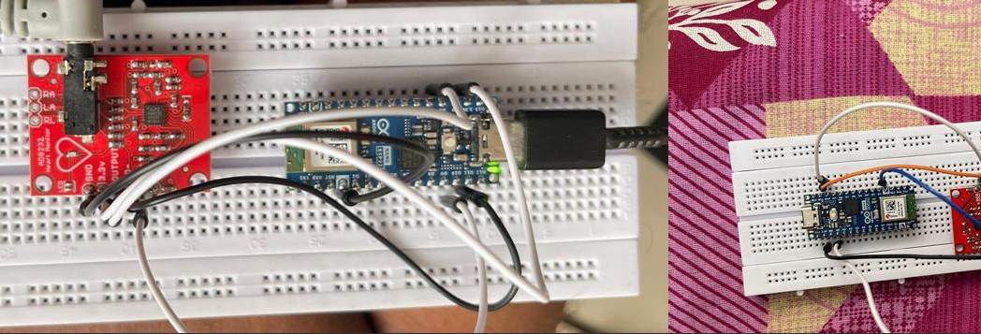
MANUAL ECG SIGNAL

Slide 29

MANUAL ECG SIGNAL

Slide 30
STANDARDS USED
MIT-BIH Arrhythmia Database Standard
→ For ECG signal dataset and annotations.
ANSI/AAMI EC57:2012 Standard
→ For performance testing and reporting of cardiac anomaly detection algorithms.
IEC 60601-2-47 Standard
→ For medical device safety and performance in ECG monitoring systems.
IEEE 1708-2014 Standard
→ For wearable ECG-based monitoring devices.
ISO/IEC 20546:2019 Standard
→ For big data analytics model evaluation like accuracy, precision, recall, F1-score.
ISO/IEC 2382-37 Standard
→ For terminology and process of artificial intelligence and machine learning.

Slide 31
STANDARDS USED
ISO/IEC 25010 Standard
→ For software quality evaluation including metrics like precision, recall, and accuracy.
GDPR & HIPAA Compliance
→ For ensuring privacy and security of sensitive ECG data.

Slide 32
Conclusion and Future Work
Summary & Next Steps
Key Findings:
  Successful real-time ECG anomaly detection.
  AI-based model improves accuracy & efficiency.
Challenges Faced:
  Noise interference, dataset limitations, model tuning.

Slide 33
Future work
Future Work:
  Optimize deep learning model for higher accuracy.
  Expand dataset for better generalization.
  Implement in a wearable ECG patch for real-time monitoring.

Slide 34
OUTCOMES
Using deep learning models and custom-built dry electrodes, this work effectively created an ar tificial intelligence-based ECG abnormality detection system. While balancing computational efficiency for real-time wearable devices, the CNN and CNN-LSTM models shown great ac curacy (up to 97.8 PERCENT). Three square and three circular dry electrodes enhanced signal capture quality without the necessity of conductive gels, therefore enabling continuous mon itoring more practically. Furthermore investigated were Explainable AI (XAI) approaches to improve clinical setting model interpretability and trust

Slide 35
REFERENCES
[1] U. R. Acharya, S. L. Oh, Y. Hagiwara, J. H. Tan, and M. Adam. A deep convolutional neural network model to classify heartbeats. Computers in Biology and Medicine, 89: 389–396, 2017.
[2] U. Amin, G. Swapna, and K. P. Soman. Anomaly detection in ecg signals using deep learning techniques. Biomedical Engineering Letters, 9(1):101–111, 2019.
[3] R. Bousseljot, D. Kreiseler, and A. Schnabel. The ptb diagnostic ecg database. PhysioNet, 1995.
[4] W. Chen, R. Hu, J. Wang, and X. Fang. An attention-based deep learning model for ecg anomaly detection. IEEE Transactions on Neural Networks and Learning Systems, 32 (10):4325–4336, 2021.
[5] A. L. Goldberger, L. A. N. Amaral, L. Glass, J. M. Hausdorff, P. C. Ivanov, R. G. Mark, J. E. Mietus, G. B. Moody, C. K. Peng, and H. E. Stanley. Physiobank, physiotoolkit, and physionet: Components of a new research resource for complex physiologic signals. Circulation, 101(23):e215–e220, 2000

Slide 36
REFERENCES
[6] A. Y. Hannun, P. Rajpurkar, M. Haghpanahi, G. H. Tison, C. Bourn, M. P. Turakhia, and A. Y. Ng. Cardiologist-level arrhythmia detection with deep neural networks. Nature Medicine, 25(1):65–69, 2019.
[7] M. Kachuee, S. Fazeli, and M. Sarrafzadeh. Ecg heartbeat classification: A deep transfer able representation. IEEE International Conference on Healthcare Informatics, 5:881 886, 2018.
[8] Y. Liu and J. Zhang. Ecg classification using ensemble deep learning models. Neural Computing and Applications, 34(4):1783–1792, 2022.
[9] R. J. Martis, U. R. Acharya, and L. C. Min. Ecg beat classification using pca, lda, ica, and discrete wavelet transform. Biomedical Signal Processing and Control, 8(5):437–448, 2013.
[10] A. Minchol´e and B. Rodriguez. Artificial intelligence in the electrocardiogram: Chal lenges and opportunities. Nature Reviews Cardiology, 16:547–558, 2019

